Slide 1
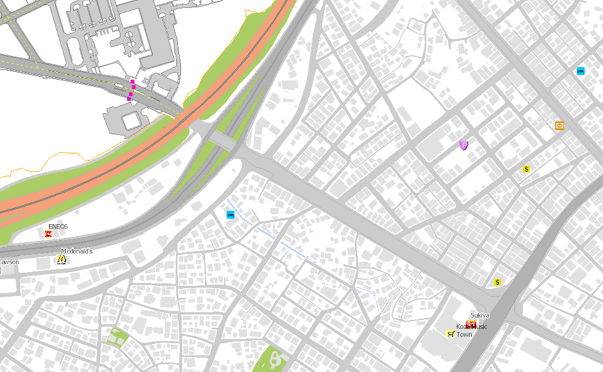
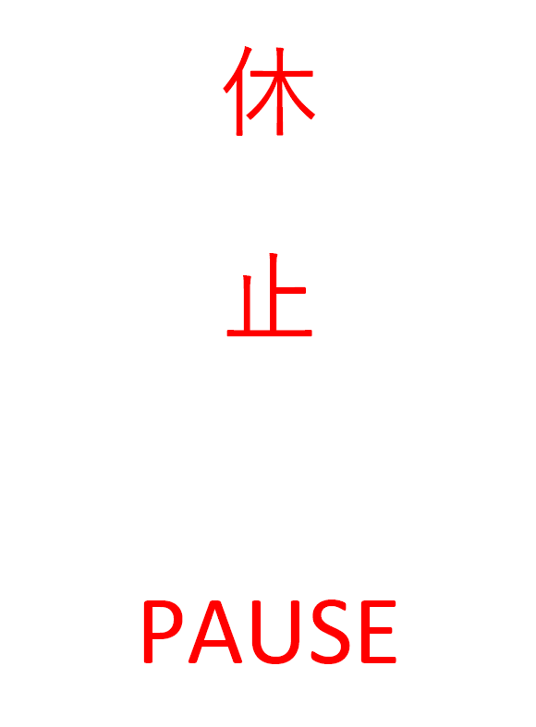
Kadena Gate 2
No Parking Zone
HWY 330
Koza Music Town
Rt 20

Slide 2
This is the sign posted on the parking meters along Gate 2 Street, indicating the meters are not in service.

